Slide 1
CAP-316
Computing Professional Practices and Ethics
Privacy Protection and the Law
Dr. Narinder Singh Rana
Associate Professor – School of Computer Application
Lovely Professional University

Slide 2
Information Privacy
Information privacy is the combination of communications privacy (the ability to communicate with others without those communications being monitored by other persons or organizations) and data privacy (the ability to limit access to one’s personal data
by other individuals and organizations in order to exercise a substantial degree of control over that data and its use)
Dr. Narinder Singh Rana, Lovely Professional University

Slide 3
Privacy Laws In US
Financial Data
Health information
Children’s personal data
Electronic surveillance
Fair information practices
Access to government records
Dr. Narinder Singh Rana, Lovely Professional University

Slide 4
Financial Data
Fair Credit Reporting Act (1970)
Right to Financial Privacy Act (1978)
Gramm-Leach-Bliley Act (1999)
Fair and Accurate Credit Transactions Act (2003)
Dr. Narinder Singh Rana, Lovely Professional University

Slide 5
Health Information
Health Insurance Portability and Accountability Act (1996)
The American Recovery and Reinvestment Act (2009)
Dr. Narinder Singh Rana, Lovely Professional University

Slide 6
Children’s Personal Data
Family Educational Rights and Privacy Act (1974)
Children’s Online Privacy Protection Act (1998)
Dr. Narinder Singh Rana, Lovely Professional University

Slide 7
Electronic Surveillance
Communications Act (1934)
The Foreign Intelligence Surveillance Act (FISA) (1978)
Electronic Communications Privacy Act (1986)
Communications Assistance for Law Enforcement Act (1994)
USA PATRIOT Act (2001)
Dr. Narinder Singh Rana, Lovely Professional University

Slide 8
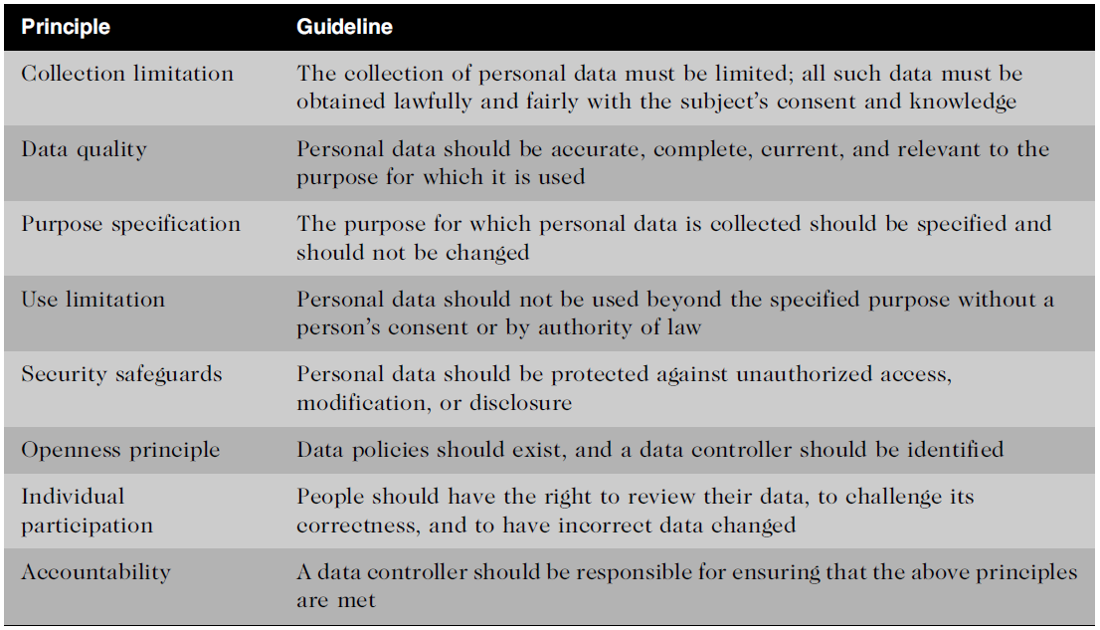
Fair Information Practices
Dr. Narinder Singh Rana, Lovely Professional University

Slide 9
Freedom of Information Act (FOIA) grants citizens the right to access certain information and records of federal, state, and local governments upon request.
Dr. Narinder Singh Rana, Lovely Professional University

